Slide 1
ShanghaiTech University
EE 115B: Digital Circuits
Fall 2024
Lecture 19
Hengzhao Yang
December 24, 2024

Slide 2
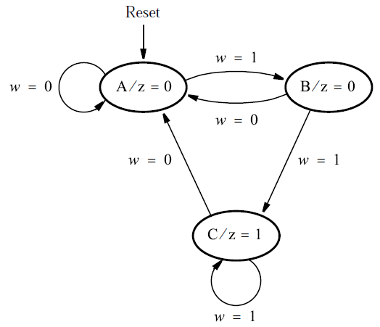
VHDL code for Moore FSMs
Design input: state diagram
Example: “11” sequence detector

Slide 3
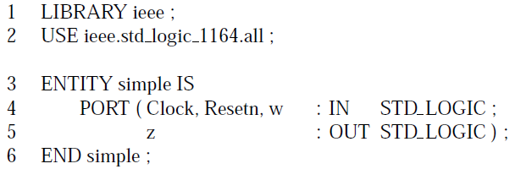
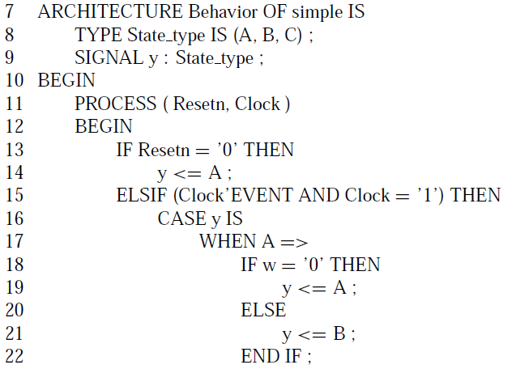
Moore type: code 1
TYPE keyword
  User-defined signal type
  Name: State_type
  Values: A, B, C
Signal y
  Type: State_type
  Describes FSM state
  Takes values (A, B, C)
Initial state A by Resetn
CASE statement
  State transitions

Slide 4
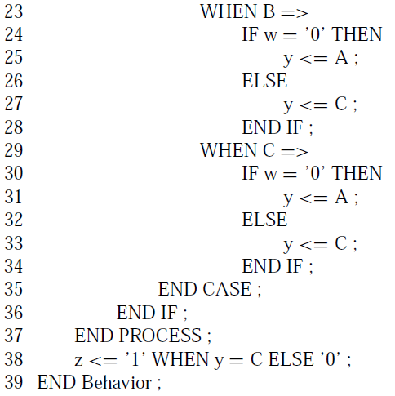
Moore type: code 1 (continued)
WHEN statement
  Output expression
Summary
  One signal (y) for state
  One PROCESS block

Slide 5
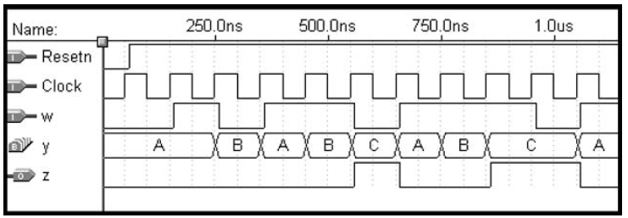
Moore type: code 1, simulation results
Signal y: state

Slide 6

Moore type: code 2
Same ENTITY
Two signals for state
  Present state: y_present
  Next state: y_next
  Same type: State_type
  Same values: A, B, C
Two PROCESS blocks

Slide 7
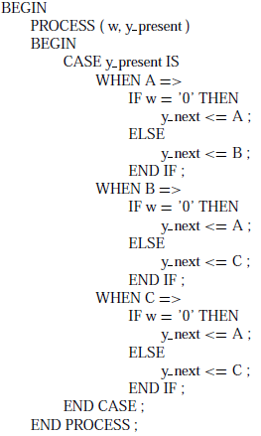
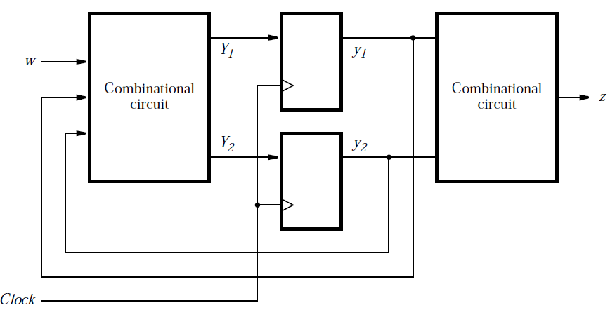
Moore type: code 2 (continued)
PROCESS 1
  Next-state expressions
  Left combinational circuit

Slide 8
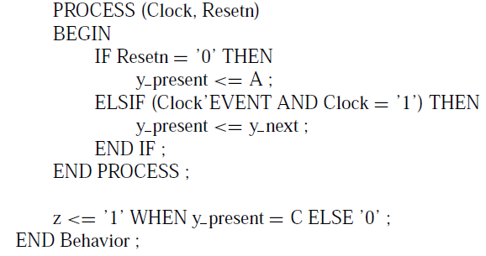
Moore type: code 2 (continued)
PROCESS 2
  State update
  Sequential circuit
WHEN statement
  Output expression
  Right combinational circuit

Slide 9
Moore type: code 3
Code 1 and 2
  Automatic state assignment
  Type of state signals (y, y_present, y_next): user-defined (State_type)
Code 3
  Manual (explicit) state assignment
  Type of state signals: standard (std_logic_vector)

Slide 10
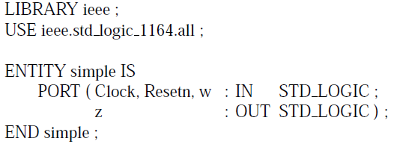
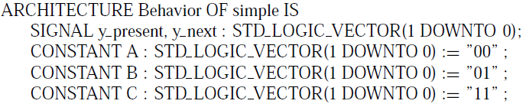
Moore type: code 3 (continued)
State assignment
  A: 00, B: 01, C: 11
State signals
  y_present, y_next: 2-bit vector
  States and values: A=“00”, B=“01”, C=“11”
  State is defined as CONSTANT
  Operator for CONSTANT value assignment: “:=”

Slide 11
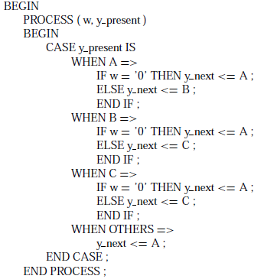
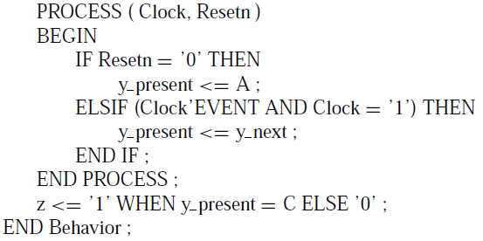
Moore type: code 3 (continued)
PROCESS 1 (right)
  WHEN OTHERS
    Covers unused values
PROCESS 2 (left)
Output (left)

Slide 12
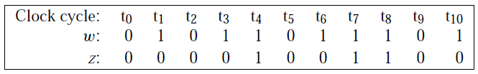
Mealy FSM
Sequence detector
  Circuit has one input (w) and one output (z)
  All changes occur at positive clock edges
  Operation: z=1 in the same clock cycle when the second occurrence of w=1 is detected; z=0, otherwise

Slide 13
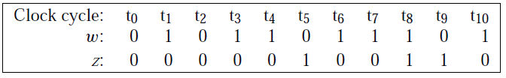
Comparison: Moore FSM
Design specifications (problem statement)
  Circuit has one input (w) and one output (z)
  All changes occur on positive clock edges
  Operation: z=1 if w=1 during two immediately preceding clock cycles; z=0, otherwise

Slide 14
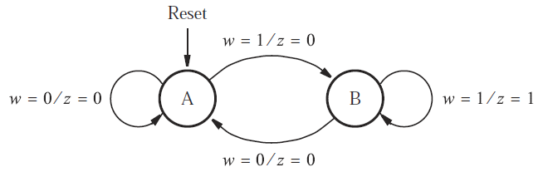
State diagram
States
  State A (starting state): when a reset signal is applied or w=0, circuit enters this state
  State B: w=1 for one clock cycle

Slide 15
Comparison: Moore FSM
State diagram
  Nodes: states
  Directed arcs: state transitions

Slide 16
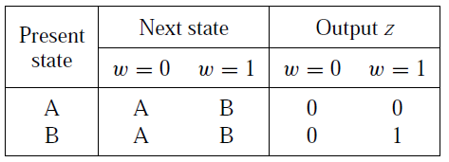
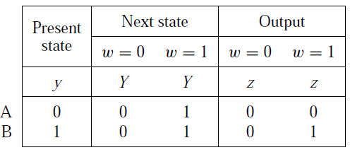
State table and state-assigned table
Two states: A and B
One state variable: y
  A: 0, B: 1

Slide 17
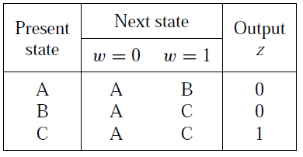
Comparison: Moore FSM
Convert state diagram to state table
  First state is starting state (state A)
  Present state, next state, and state transitions
  Output is specified with respect to present state

Slide 18

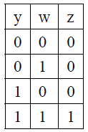
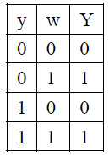
Output and next-state expressions
Expressions
Truth table: output and next-state

Slide 19
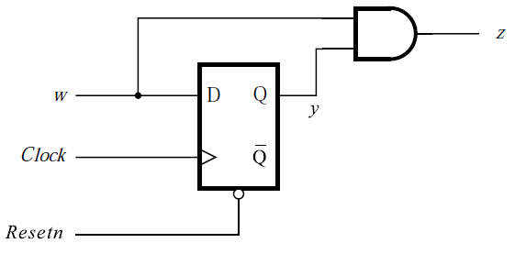
Circuit
Expressions

Slide 20
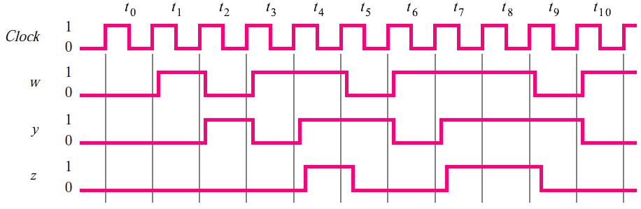
Timing diagram

Slide 21
VHDL code for Mealy FSMs
Design input: state diagram
Example: “11” sequence detector

Slide 22
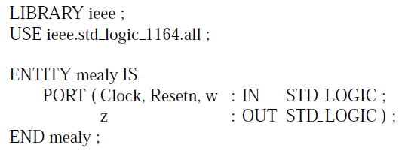

Mealy type code
Similar to Moore type code 1
Two states: A, B
User-defined state signal type: State_type

Slide 23
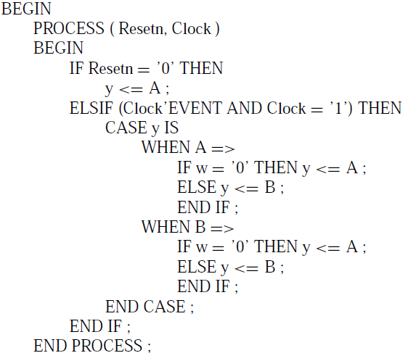
Mealy type code (continued)
PROCESS 1
  State transitions

Slide 24
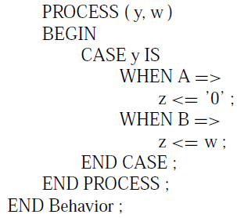
Mealy type code (continued)
PROCESS 2
  Output depends on y and w

Slide 25
Chapter 9 Data Conversion
Analog to digital conversion (ADC)
Digital to analog conversion (DAC)

Slide 26
Analog to Digital Conversion

Slide 27
1. A/D转换的基本原理
输入：连续的模拟量，输出：不连续的数字量
2. ADC的关键步骤
  采样 (sampling)
  量化 (quantization)
A/D
A (电压 或 电流)
D (binary code)

Slide 28
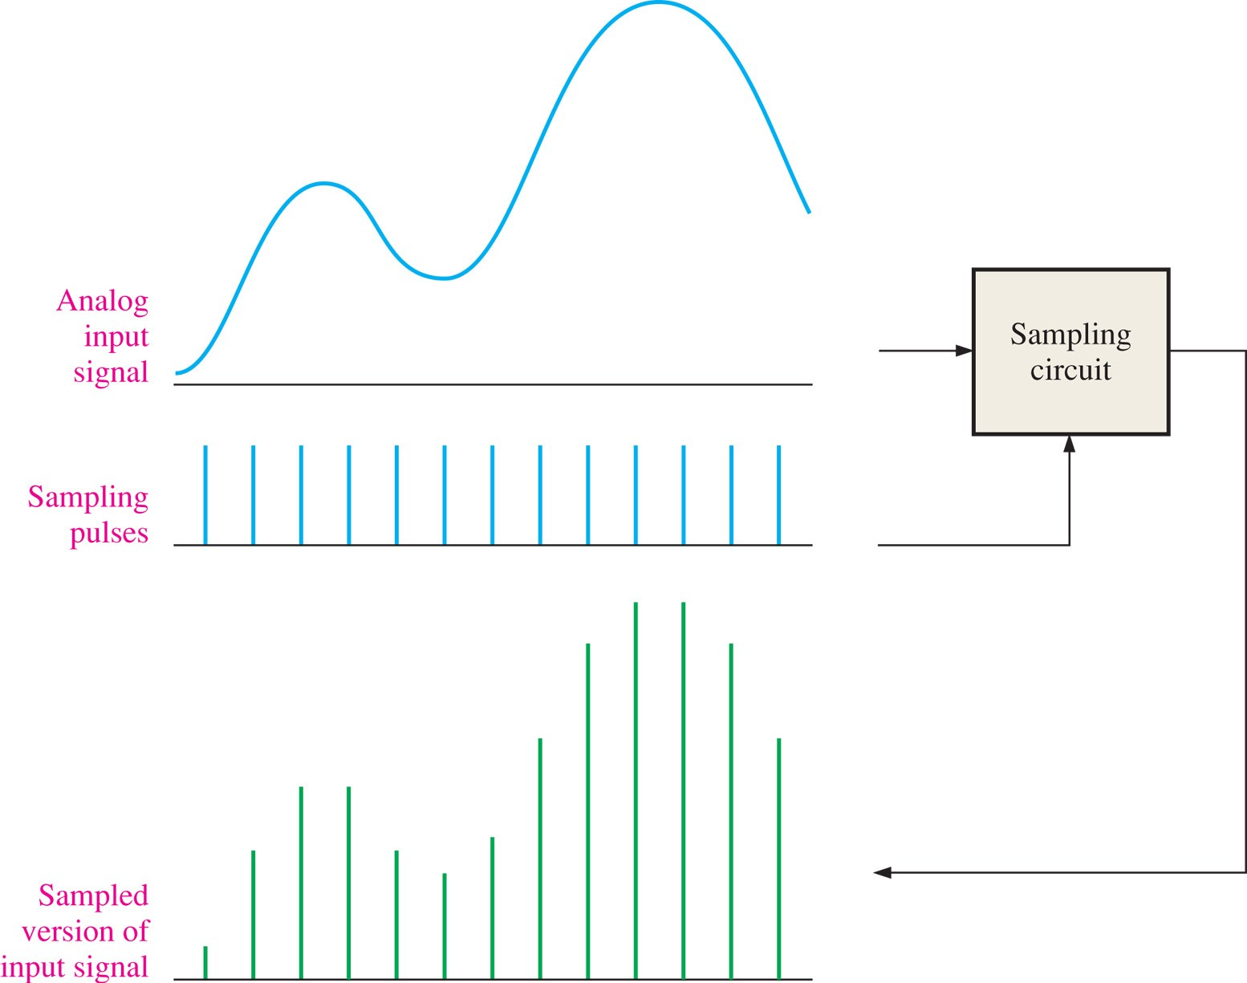
FIGURE 12-1 Illustration of the sampling process.

Slide 29
Sampling
Sampling frequency f_{s}
  How fast must we sample to ensure a reasonable error in recovering the analog signal?
Nyquist Theorem (Sampling Theorem)
  Suppose the highest frequency of a signal is f_{B}. For a complete recovery of the signal from its samples, the sampling rate, f_{s}, must satisfy f_{s}>2f_{B} (Nyquist rate: 2f_{B}).

Slide 30
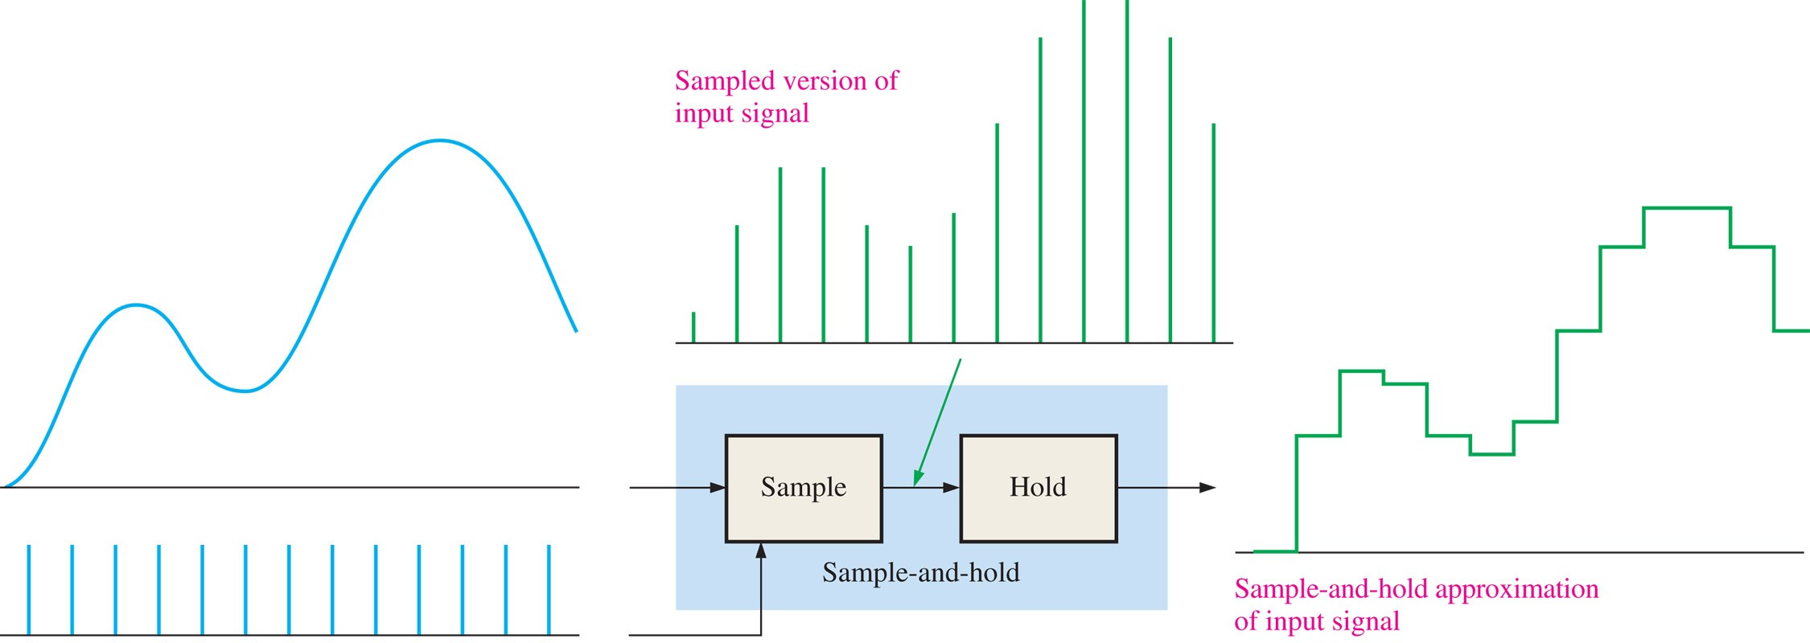
FIGURE 12-5 Illustration of a sample-and-hold operation.

Slide 31
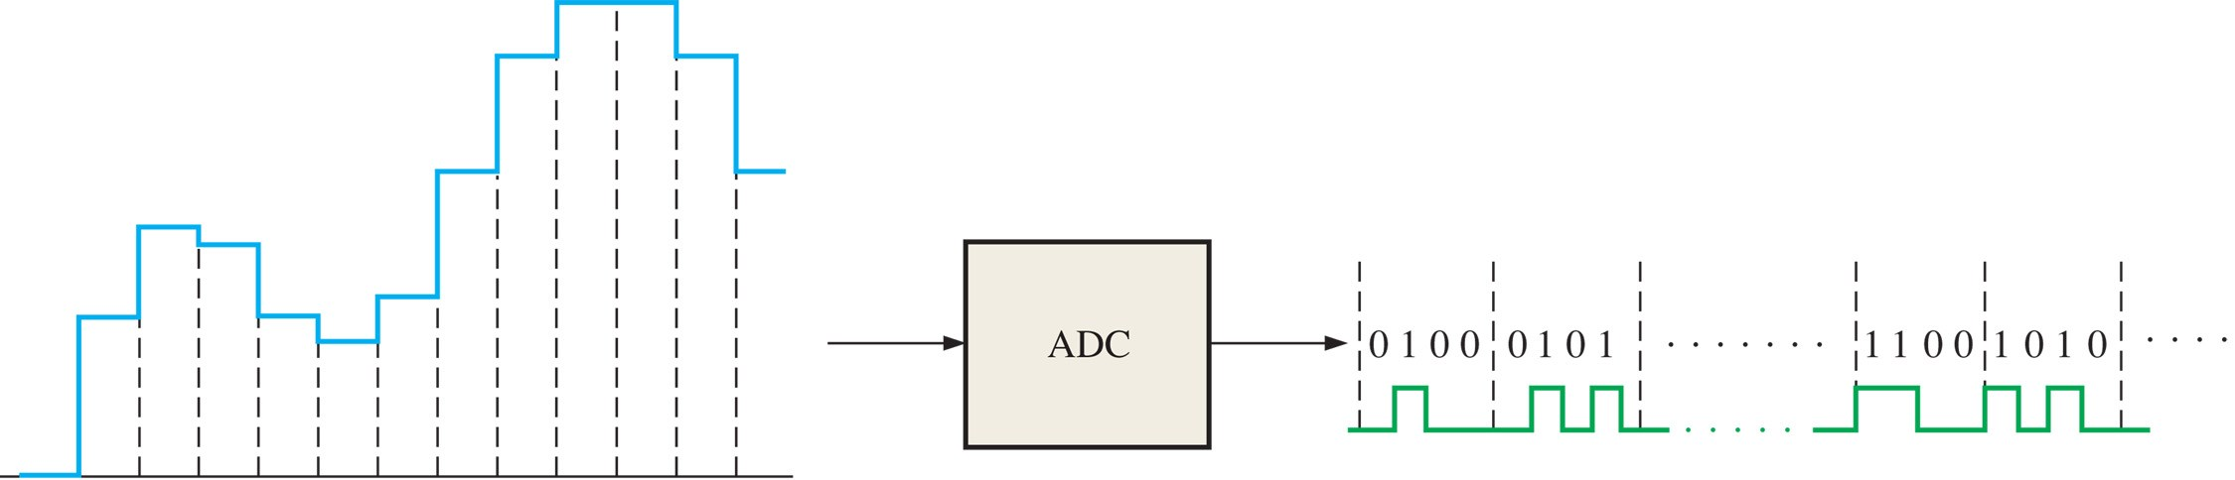
FIGURE 12-6 Basic function of an analog-to-digital converter (ADC) (The binary codes and number of bits are arbitrarily chosen for illustration only). The ADC output waveform that represents the binary codes is also shown.

Slide 32
Quantization
ADC requires sampling the analog signal (from continuous time to discrete time) and quantizing the sample amplitudes (from continuous value to discrete value)
Each quantization level is encoded as a binary code (binary word)
  Quantization level: value of physical parameter (e.g. voltage)
  Binary code: digital representation of quantization level (e.g., 111 for 1 V)

